Slide 1
Introduction to ChibiOS/RT
A free embedded RTOS
http://www.chibios.org

Slide 2
Goals
A complete Operating System not just a RTOS
Abstraction of inner details
Ease of development
Portability across architectures and compilers
Efficiency, speed and code size

Slide 3
Project Audience
Automotive
Robotic Applications
Consumer Electronics
Energy Management
Teaching and Learning RTOS technology
Hobby, DIY

Slide 4
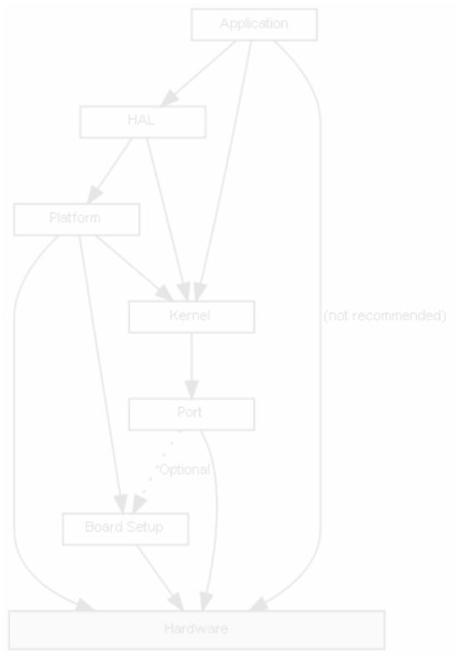
Features
Very advanced RTOS kernel
Layered Hardware Abstraction Layer
Integration of external components (lwIP, FatFS)
Debug tools for Eclipse
PC simulator
Complete Test Suite and many test applications

Slide 5

Advanced RTOS kernel #1
Fully static
Software Timers
Multi Threading
Excellent debug support
Support for Interrupts Nesting and Zero Latency

Slide 6
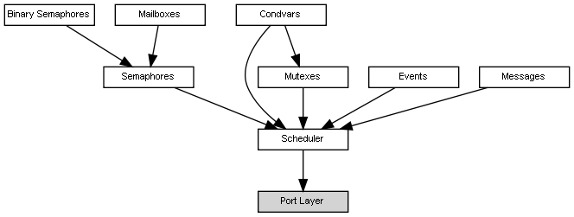
Advanced RTOS kernel #2
Rich synchronization and communication primitives
Support for Priority Inheritance

Slide 7
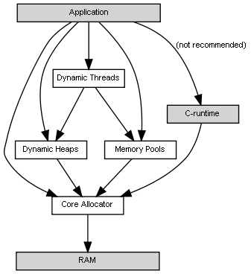
Advanced RTOS kernel #3
Unified Memory Management
Support for Dynamic Threading

Slide 8
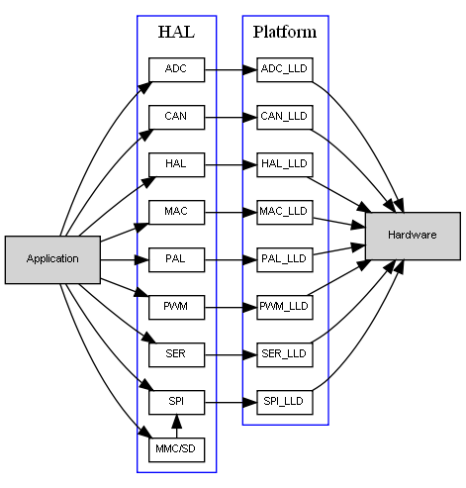
Layered HAL
Abstraction of many common device drivers:
Port, Serial, ADC, CAN, EXT, GPT,
I2C, ICU, MAC, MMC, PWM, RTC,
SDC, SPI, TM, UART, USB
Focus on the application not the hardware

Slide 9

External Components
uIP, minimal TCP/IP stack
lwIP, lightweight TCP/IP stack
FatFS, simple FAT file system
ChibiOS/GFX, community-driven graphic subsystem

Slide 10
Supported Architectures
Core Architecture | Compiler | Supported Platforms
ARM Cortex-M0 (ARMv6-M) | GCC/IAR/RVCT | LPC11xx, LPC11Uxx, STM32F0xx
ARM Cortex-M3 (ARMv7-M) | GCC/IAR/RVCT | LPC13xx, STM32F1xx, STM32F2xx, STM32L1xx
ARM Cortex-M4 (ARMv7-ME) | GCC/IAR/RVCT | STM32F4xx
ARM7 | GCC | AT91SAM7x, LPC214x
MegaAVR | GCC | ATmega128, AT90CAN128
MSP430 | GCC | MSP430F1611
Power Architecture e200z | GCC | SPC563Mx, MPC563x
STM8 | Cosmic/IAR/Raisonance | STM8L, STM8S
Many others supported by community

Slide 11
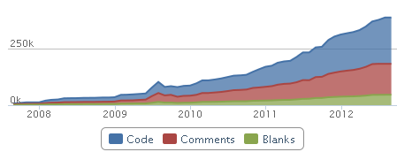
Project Strengths
Not just a RTOS but a complete Operating System
Solid Architecture
Extensive documentation and technical articles
Performance and Footprint
Strong hardware and compiler Abstraction
Growing codebase and active Community

Slide 12
Future Plans
Support for even more Architectures
Improve tools support
Support the growth of community
Continued commitment to the FOSS model
RTOS variants

Slide 13
Licensing Options
Pure GPL3
  Free
  Oriented to DIY
  Full access to the code
GPL3 with linking exception
  Free
  Usable for small business
  Restrictions to code access
Commercial
  Business oriented
  Full access to the code for “source” licenses
  Priority support

Slide 14

End of Introduction

